Slide 1
INTRODUCTION
TRACK NAME: Data Analytics
TEAM MEMBERS:
1. P.Madhavi Latha (20KE1A1251)
2.K.MaryPranathi(20KE1A1225)
3.D.Naga UshaSri(20KE1A1208)
4.M.Kalyani(20KE1A1242)

Slide 2

TITLE OF THE PROJECTTHTTE PROJECT

Slide 3
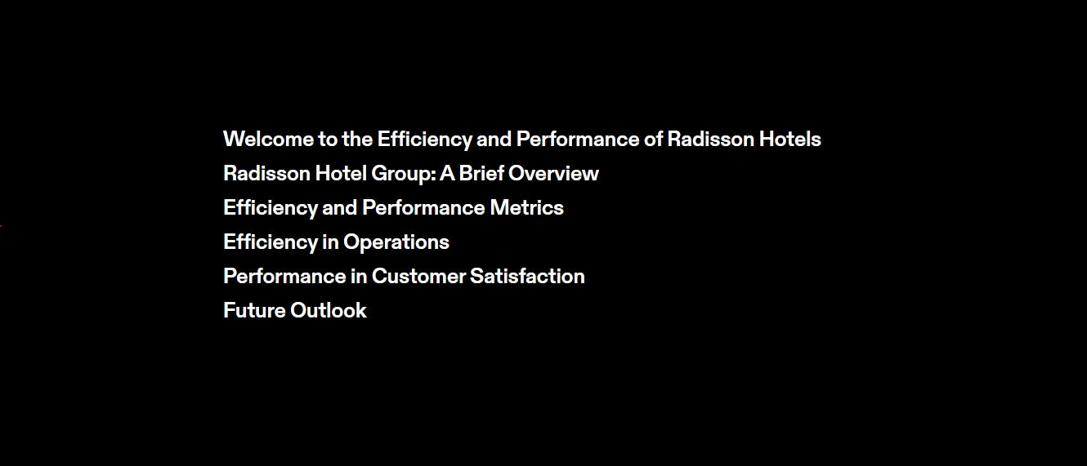
tt
OOOBJECTIVE OF PROJECT

Slide 4


Slide 5
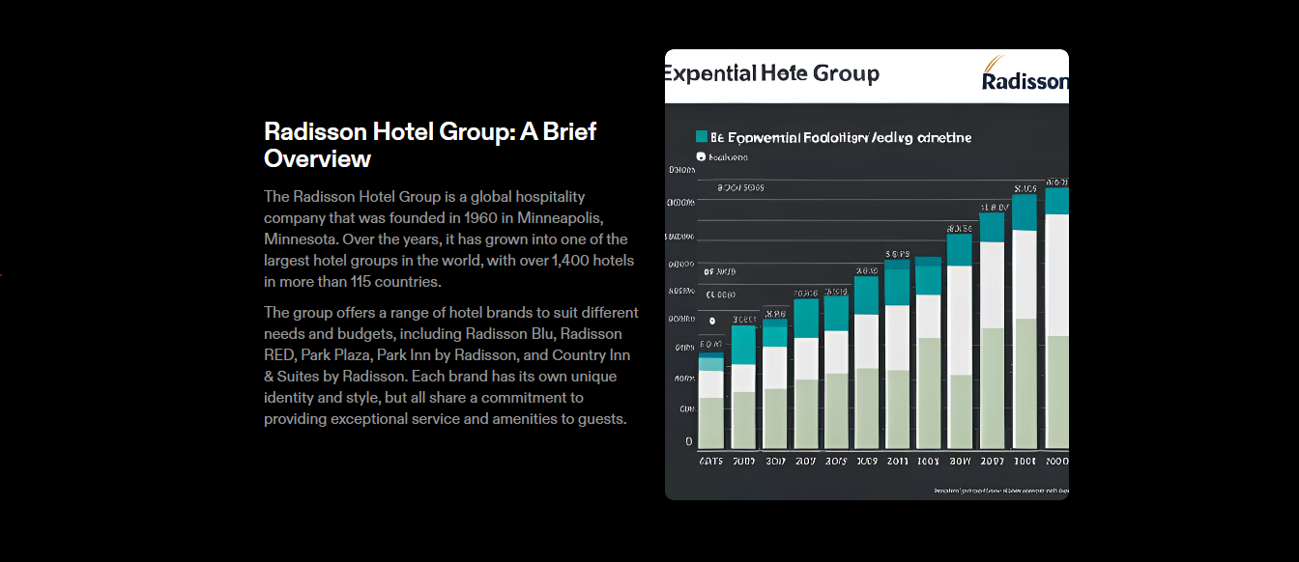

Slide 6
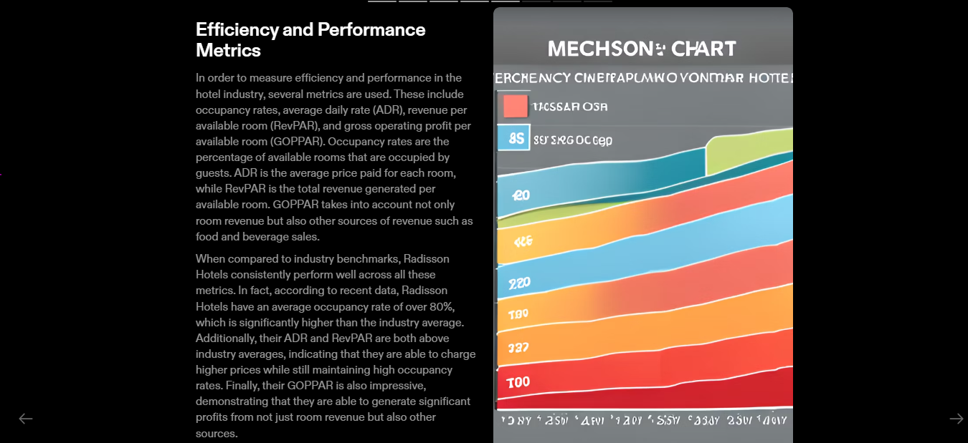

Slide 7
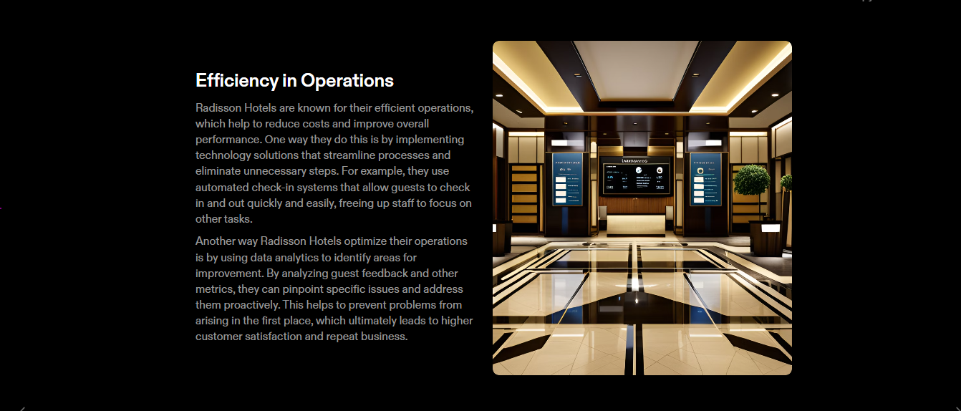

Slide 8
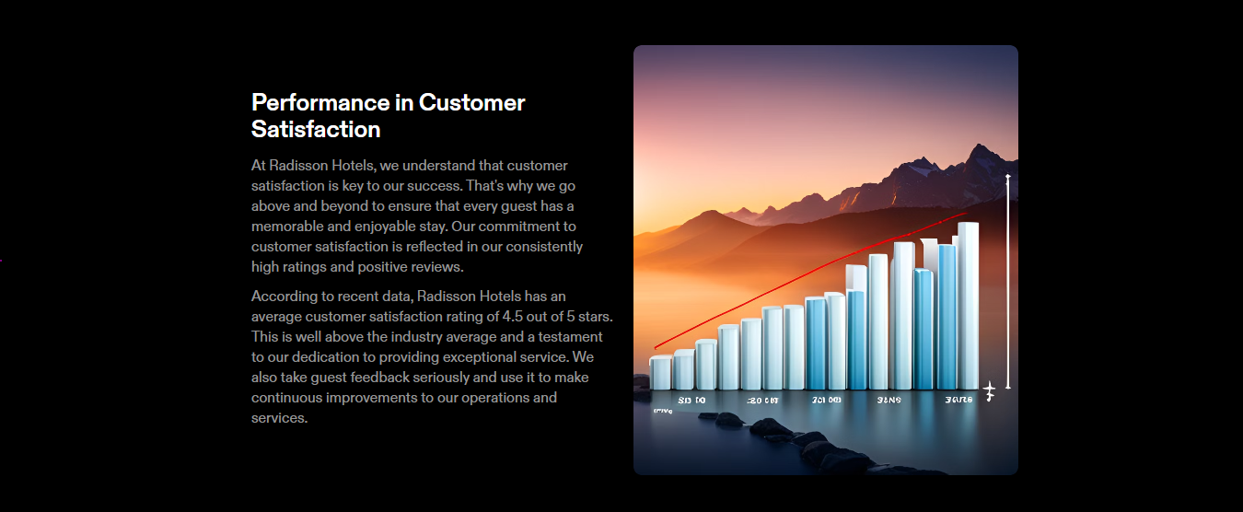

Slide 9
